Slide 1
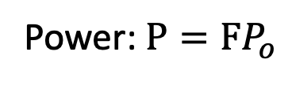

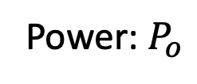
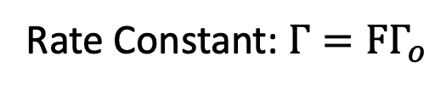
(a) In vacuum
(b) In a structure
Power: $P=FP_{o}$
Rate Constant: $Γ=FΓ_{o}$
Power: $P_{o}$
Layer 1
$$d_{1}$$
Intrinsic Rate Constant: $Γ_{o}$
Layer 2
$$d_{2}$$
$$……$$
$$d_{i}$$
$$……$$
Only an ensemble of emitter is supported.
Layer m-1
$$d_{m−1}$$
Layer m
$$d_{m}$$

Slide 2
start
Load Material/User
start
Load Structure/Structure List
recommended
k/ko max.
Tolerance
Recursive Limit
checkbox
Load Reference Purcell Factor
Calculate
Purcell factor
It is recommended to use the default settings.

Slide 3


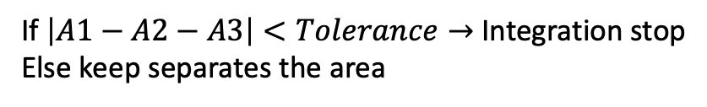
A. Points along kt/ko
Numerical Integration: A1
kt/ko max.
0
$$\frac{k_{t}}{k_{o}}$$
start points
B. Separate into two pieces
Numerical Integration: A2
kt/ko max.
Numerical Integration: A3
$$\frac{k_{t}}{k_{o}}$$
start points
start points
If $\left|A1−A2−A3\right|<Tolerance→$ Integration stop
Else keep separates the area

Slide 4
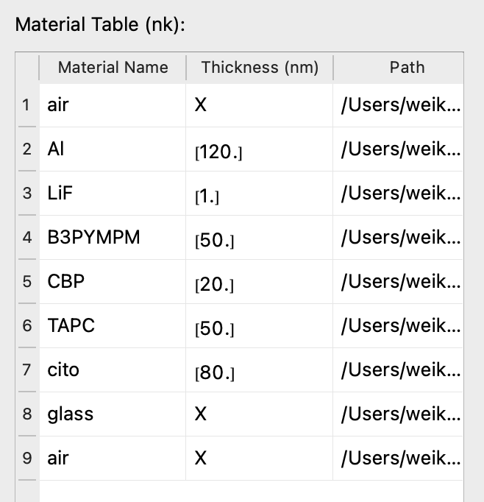
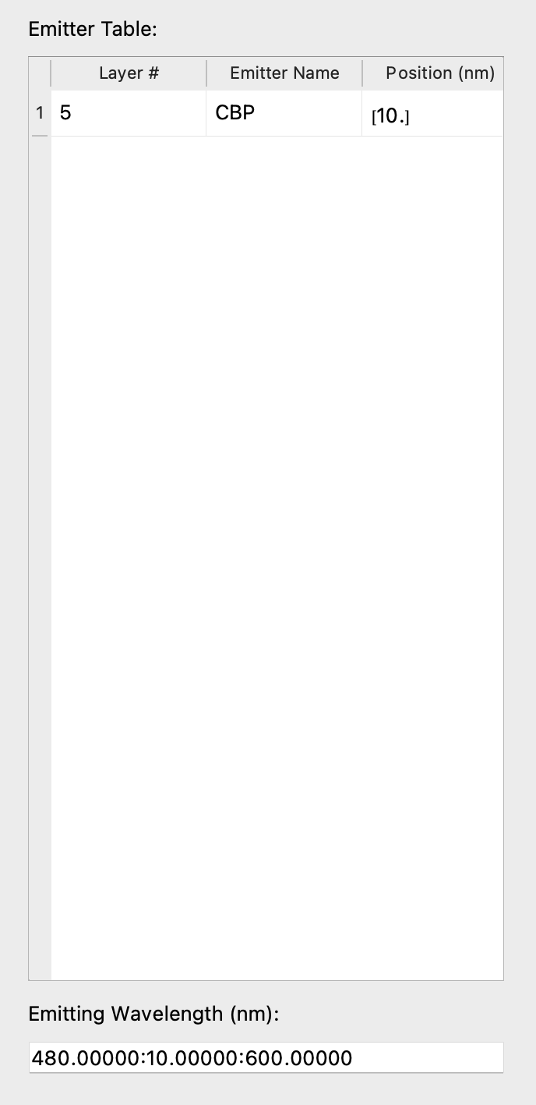
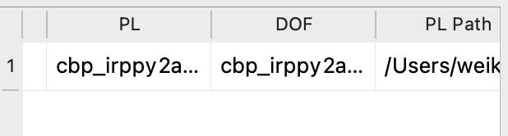
(a) device structure
(b) EML
(c) emitting wavelength

